Slide 1
Protein Changes in the Aging Heart
Daniel Alfonsetti
JAX Summer Student Program 2018
Notes:
Hi friends, my name is Daniel. I’ve been working in the Churchill lab this summer studying how proteins change in the heart as you age.

Slide 2
Background
Cardiovascular disease is the leading cause of death in the US and the world
A strong predictor of CV health is having healthy parents
Evidence for genetic component
Perls T, Terry D. Understanding the determinants of exceptional longevity. Ann Intern Med. 2003 Sep 2;139(5 Pt 2):445-9. Review. PubMed PMID: 12965974.
Notes:
So why is this research important? Well, its because cardiovascular disease are the leading cause of death in the world.
Researches have also found that if you have parents with good CV health, than you are more likely to have good CV. This suggests a genetic component.

Slide 3
The Data
189 genetically diverse mice
6, 12, 18 months; both sexes
Measured abundance of 4193 heart proteins
Notes:
The data that I used came from a cross-sectional study with 189 diversity outbreed mice grouped by age of sacrifice. For each mouse, the expression levels of about forty two hundred proteins were measured. I’d just like to emphasize that this is not a longitudinal study; we weren’t following each mouse as they aged. Each mouse was scarified at different ages in order to measure the protein in their heart.

Slide 4
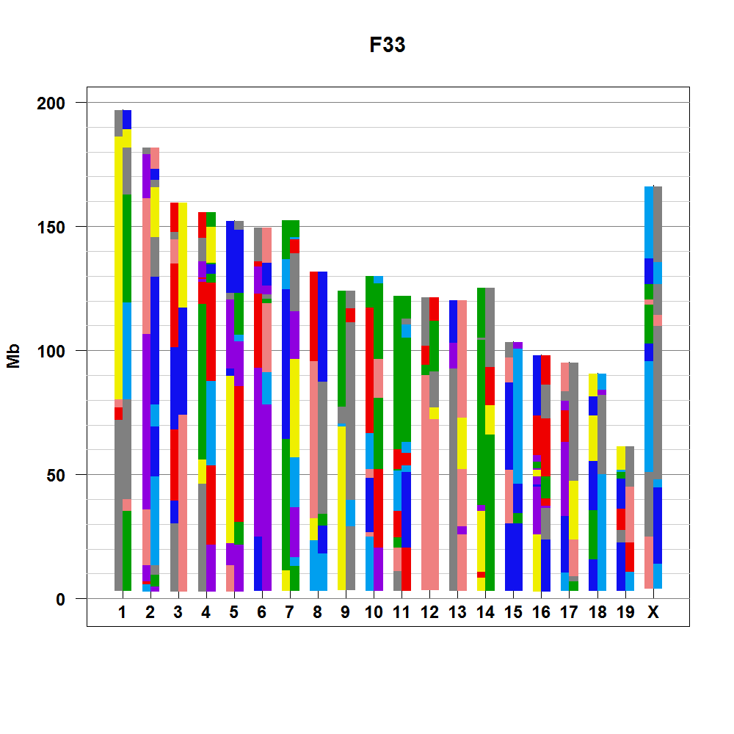
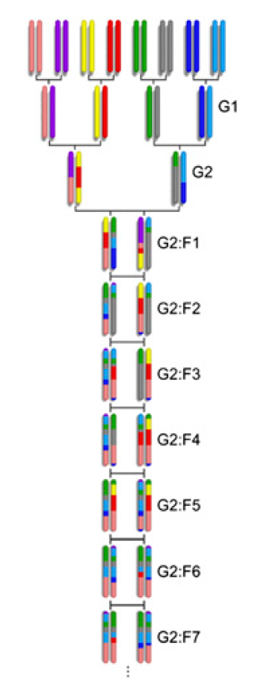
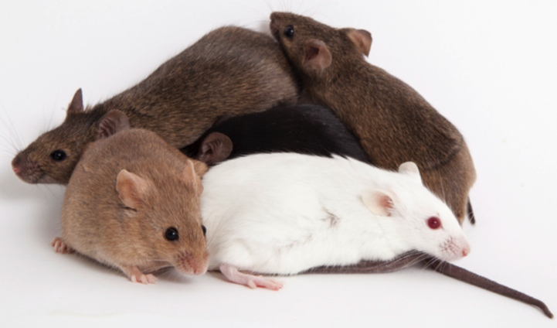
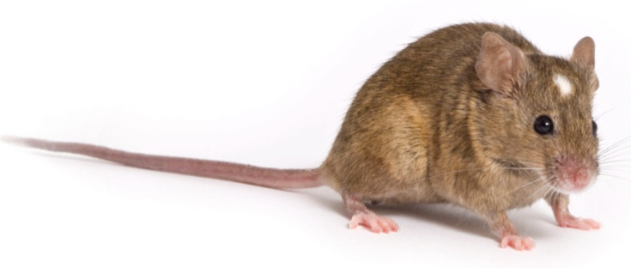
Diversity Outbred
Collaborative Cross
Founder
Strains
Multiparental
Population
(DO)
Partially Inbred
Progenitors
Inbred
Strain
(CC)
Randomized Breeding
Notes:
So like I said, my mice were diversity oubred, or “DO” mice. So I’ll give you a quick history of them. First there were the 8 founder strains. Each strain is completely inbred and homozygous at every location on their genome. The mouse within each strain are clones of each other. These strains were then funnel bred for three generations to mix up their genomes, and then inbred for 20 generations to create inbred ”collaborative cross strains” that are also homozygous at every SNP. The DO mice, my mice, on the other hand, were not inbred and instead were outbred after funnel breeding. This creates mice that are not clones and that are more genetically diverse to better model the human population.
CCs were created with 3 generations of funnel breeding between the 8 founders and then 20 generations of inbreeding.
DO were created by continuously outbreeding different lines of CCs.
Since each DO mouse is genetically unique (they are not clones), each one must be sequenced separately. They are genotyped with the Mouse Universal Genotyping Array (MUGA).

Slide 5
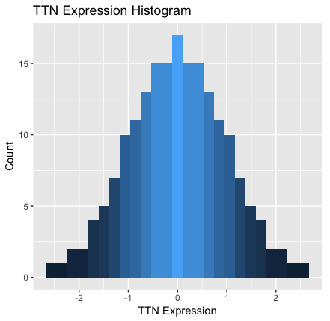
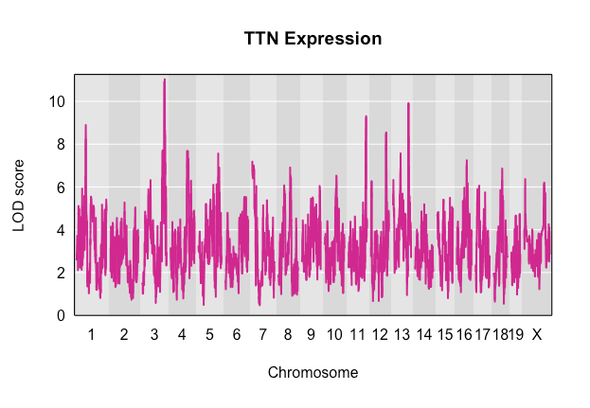
Quantitative Trait Locus (QTL) Mapping
Method of associating genome location to quantitative trait
Regress phenotype on genotype at every SNP
TTN Expression
LOD
Chromosome

Slide 6
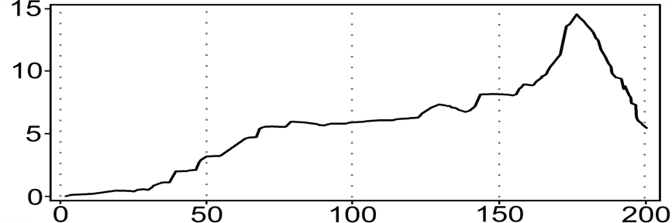
Cholesterol
AA
AB
BB
AA
AB
BB
AA
AB
BB
LOD
Chr Location
Credit: Dan Gatti
Notes:
So the bottom figure is a standard QTL graph. The x axis marks chromosome location and the y-axis essentially measures how much that area of the genome is associated with the phenotype we are measuring. Quantifying the association at each SNP in the genome is a function of how well the genotype at that SNP can predict the phenotype.
You can see that on the right hand figure, if you know the genotype at that SNP, you can make a pretty reasonable guess as to what that mouse’s cholesterol level will be, but this is not true for the figure on the left.

Slide 7
Genotype effect on expression varies with age
6 Months
12 Months
18 Months
Protein Expression
AA
AB
BB
AA
AB
BB
AA
AB
BB
LOD
Chr Location
Notes:
Okay, so that’s nice, but we want to do something a bit more complicated since we want to see how genetic variation affects the way protein expression changes in the heart with age. We are not exactly associating a phenotype to a genetic location in the conventional sense anymore, we associating the change in the phenotype with respect to some variable to a genetic location. We want to find what’s responsible for change. It’s a subtle but important difference.
To do this we use something called interactive QTLs, where in this case the interactive covariate is age.
Again, on the bottom we have a standard QTL scan plot and at the top you have plots showing how significance was derived.
You can see that protein expression is decreasing with age just by looking at the green-blue-orange stratifications, but you can see that some locations in the genome give more details about how this change is occurring. For example, on the left, the genotype gives you no new information about change in protein expression with age. In the middle one, we get some information since we see that if you are BB, you will have more protein when you are young than your counterparts. On the right, genotype gives a lot of information since we see that if you have the BB allele at that genomic location, you will start off with the most amount of protein than any of your peers, but when you are older, you will have the least. An AA allele at this location, however, will have much more steady protein expression levels throughout their lifetime.

Slide 8
Gene position
Count
QTL Position
Notes:
So here is a QTL map on the top. On the y axis we have gene position and on the x-axis we have QTL position, or the location in genome that is affecting the expression of that gene (or in this case the expression of that gene’s corresponding protein).
In these types of graphs we want to see these vertical bands, like the one here. This is important because that means there are a bunch of proteins whose change in expression is associated with this same location in the genome on chr3.

Slide 9
Notes:
Here is just a blown up view of the image on the bottom. You can see there are a little more than 43 proteins whose change in expression with respect to age is associated with this genome location chromosome 3. And now I’m going to tell you about a few of these genes.

Slide 10

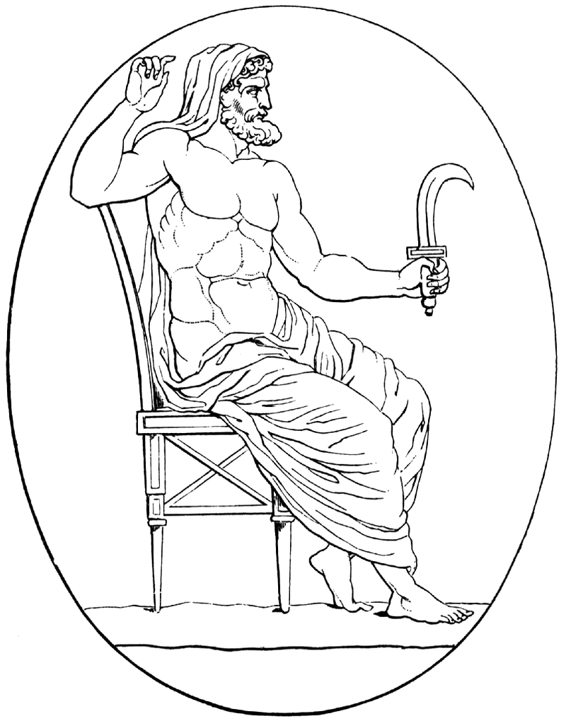
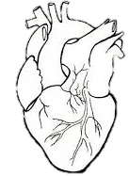


Genes
Ttn – Titin. Largest protein. provides structure, flexibility, and stability to sarcomeres
Myh3/Myh6 – Myosin heavy chain 3 and 6. Structural component of sarcomeres; helps generate mechanical force needed for contraction
Mybpc3 – cardiac myosin binding protein C, keeps thick filaments in cardiac sarcomeres from breaking down
Actg2 - gamma (γ)-2 actin. Forms filaments useful in muscle contraction
Enriched Categories
Cardiac muscle tissue morphogenesis
Regulation of heart rate
Cardiac muscle contraction
Hypertrophic Cardiomyopathy
Notes:
Ttn – Largest protein in the human body. It’s even larger in the mouse. 3,816,188.13 g/mol in the human, 3,906,487.6 g/mol in the mouse. https://en.wikipedia.org/wiki/Titin
Myh6 - https://ghr.nlm.nih.gov/gene/MYH6
Mybpc3 – Also regulates speed of contraction. https://ghr.nlm.nih.gov/gene/MYBPC3
Enriched categories for this hotspot were related to cardiac muscle.

Slide 11
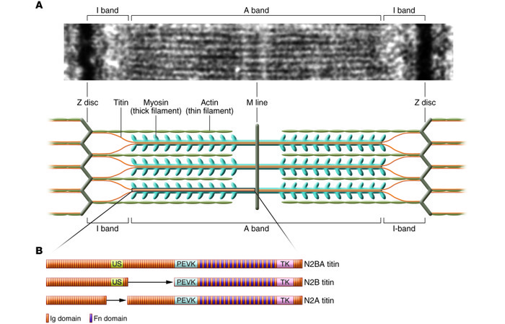
Notes:
So there are long muscle fibers in the heart that are called myocytes, and they contain these long strains that run the length of the cell called myofibrils. And in each myofibril are a series of things called sarcomeres. The sarcomeres are the fundamental unit of muscle contraction. They have thick and thin filaments that slide past each other. You can see that the thick filaments are made of myosin, the thin filaments are made of actin, and the titin is attached to the myosin. And remember that Titin, myson, and actin were all genes that were in my hotspot.

Slide 12
TTN Expression Age-Interaction QTL
LOD Score
Chr3 Position
Notes:
Here is an individual scan of the expression of a protein from the hotspot. You can see the interaction effect is pretty significant here.
LOD stands for logarithms of the odds between a model being there to no model being there.
TTN (ENSMUSP00000011934) pQTL with Age:QTL interaction

Slide 13
SNP Association
LOD score
Chr3 Position
Notes:
TTN (ENSMUSP00000011934) expression SNP association mapping plot. Interactive covariate = Age.
Underneath SNP with maximum LOD score are lincRNAs. Long intergenic non coding RNAs.
There are a lot of different ways that lincRNAs seem to regulate expression.
https://www.biosyn.com/tew/what-are-lncrnas-and-lincrnas.aspx

Slide 14
lincRNA Gene Expression Regulation Example
Baldassarre, Antonella & Masotti, Andrea. (2012). Long Non-Coding RNAs and p53 Regulation. International journal of molecular sciences. 13. 16708-16717. 10.3390/ijms131216708.
Notes:
lincRNA are still not very well understood, but there is a lot of recent of evidence suggesting that lincRNAs regulate gene expression, and this would definitely seem to make sense in the case here.

Slide 15
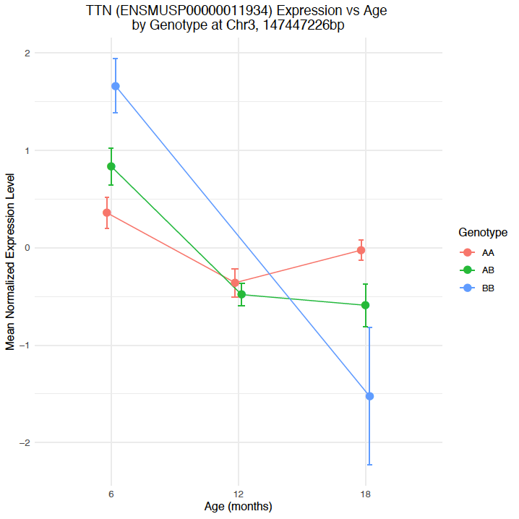
Notes:
Here we are assuming that all markers are bi-allelic, so all of the minor alleles get coded the same as “B”

Slide 17
Summary
Expression of structural heart proteins decreases with age
Rate of decline depends on genotype
Rate driven by locus at Chr3, ~148 Mbp
Regulated by lincRNA?

Slide 18
Next Steps
Wet lab work. Knockout lincRNA in mice

Slide 19
Acknowledgements
Dan Gatti, Ph.D
Gary Churchill, Ph.D (PI)
Susan McClatchy (Mentor)
Yuka Takemon
This Summer Student Fellowship was supported by Educational Gifts to The Jackson Laboratory
Notes:
And the Educational Gifts to the Jackson laboratory for allowing me to be here this summer.

Slide 20
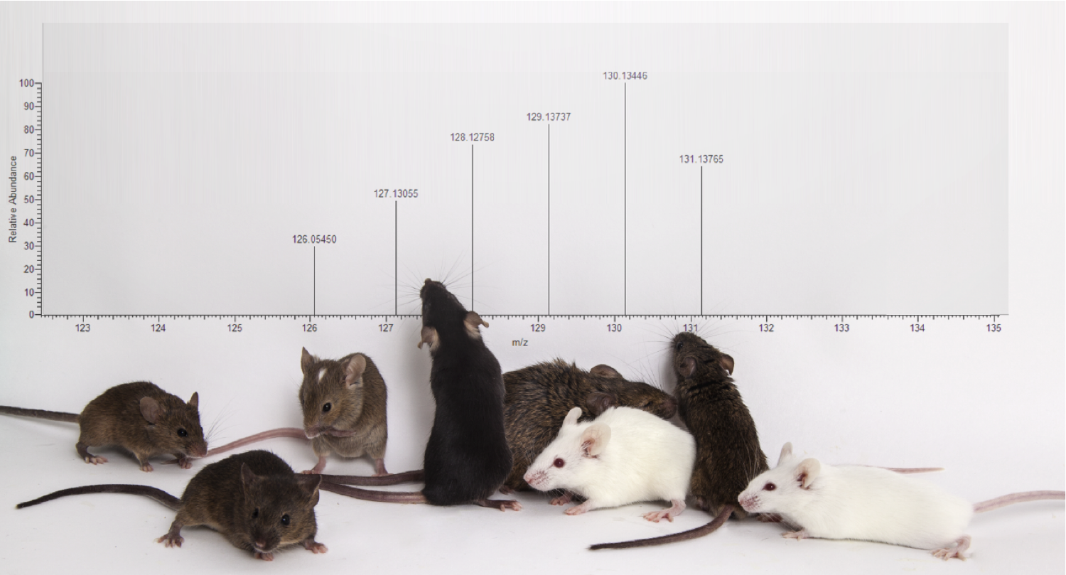
Questions?

Slide 21
Other results…

Slide 22
Fluid shear stress and atherosclerosis
Glycolysis / Gluconeogenesis
Carbon metabolism
HIF-1 signaling pathway
Cellular hormone metabolic process
Regulation of peptidase activity
Dilated cardiomyopathy (DCM)
Hypertrophic cardiomyopathy (HCM)
Adrenergic signaling in cardiomyocytes
Sphingolipid signaling pathway

Slide 23
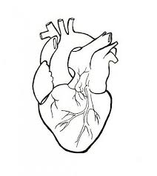

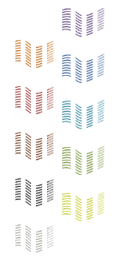
How does genetic variation influence protein abundance?
189 DO Hearts
RNA-Seq
Transcripts
Proteins
MS/MS
Short Reads
Peptides
eQTL
pQTL
eQTL Mapping
pQTL Mapping
Munger et al. 2014
Chick*, Munger* et al. Nature, 2016
Notes:
Impute individualized diploid genomes for each of the DO mice. Improves gene- and allele-level quantitation
Multiplexed quantitative proteomics performed by Joel Chick in Steve Gygi’s group at HMS.

Slide 24
Why use DO Mice?
Higher mapping resolution
More SNP locations that differ between mice
More genes and proteins will be differentially expressed
Con: Lower statistical power
More variants than across CC lines, less controlled genetics
Notes:
More SNP locations that differ between mice than locations that differ between strains of CCs (because of more observable recombination events)
“More genes and proteins will be differentially expressed.” That’s useful because
If two strains have a difference in a phenotype, say, cholesterol levels, and they are mostly genetically similar and only differ at a few SNPs, then
CCs are better for when replicate measurements are needed. So wet lab type stuff.
DOs are better for when you need to find which genes are associated with a phenotype. (There’s a better chance that with the DO, SNPs will differ between mice on the gene you are trying to look for, hence you will be able to find it)

Slide 25
Transcript-Protein Correlations
Does the amount of correlation between mRNA and their respective proteins change with age or sex?
https://en.wikipedia.org/wiki/Central_dogma_of_molecular_biology
Notes:
Okay, so back to my project. In my case, my phenotypes are not observal phenotypes, like hair color or eye, nor are they even things like blood pressure which the doctor to measure. Instead, the phenotypes my data had were the levels of mrna and protein transcript in
Yes I took the image from Wikipedia. No shame.

Slide 26
Notes:
Overall correlations between mRNA and their respective proteins decreased with ag

Slide 28
Notes:
Why does mRNA-protein correlations decrease with age? Not sure, maybe the systems are just generally breaking down and aren’t work as tightly as they were simply due increasing entropy with age.

Slide 29
Additive vs Interactive QTLs
Additive covariates: Allows means between levels of the covariate to differ in the model
Interactive covariate: Allows the genotype’s effect on the phenotype to vary with the levels of the interactive covariate
Interaction Effect: Take the difference of the full model and the purely additive model
Notes:
WE use interactive covariates in our QTL model when we want to see if the effect of the QTL on the phenotype changes with the levels of the covariates.
So in the case of age, we would be able to see if our QTL effects our phenotype differently at different points in life.

Slide 30

Mediation Analysis for Interactive QTLs
pheno ~ QTL + addcovars
pheno ~ QTL + addcovars + QTL:intcovar
interaction effect
Effect of mediator on interaction
pheno ~ QTL + addcovars + mediator
pheno ~ QTL + addcovars + mediator + QTL:intcovar
interaction effect with mediator

Slide 31
Mediation Analysis Results – Chr3 Interactive pQTL trans-band
1110002E22Rik and Syde2 mediates genotype-age interaction effect of many proteins on chromosome 3 hotspot
Notes:
Mediators within 10 Mbp (Chick and Munger paper) of QTL pos for each gene in QTL hotspot

